Slide 1
Data Science using NLP: City Of Los Angeles
Made By:
B. Sai Hemasree

Slide 2
Introduction
Help the City of Los Angeles to structure and analyze its job descriptions
The City of Los Angeles faces a big hiring challenge: 1/3 of its 50,000 workers are eligible to retire by July of 2020.

Slide 3
Steps to Tackle this problem
Convert a folder full of plain-text job postings into a single structured CSV file.
Identify language that can negatively bias the pool of applicants.
Improve the diversity and quality of the applicant pool.
How is this going to help us tackle this problem.
“MAKE IT EASIER TO DETERMINE WHICH PROMOTIONS ARE AVAILABLE TO EMPLOYEES IN EACH JOB CLASS.”

Slide 4
LOADING DATASET
Job Bulletins [Folder]
683 plain-text job postings
Instructions and Additional Documents [Folder]
Job Bulletins with Annotations
Annotation Descriptions.docx
City Job Paths
PDFs
Description of promotions in job bulletins.docx
Job_titles.csv
Kaggle_data_dictionary.csv
Sample job class export template.csv

Slide 5
LOADING DATASET
Each text file contained:
Job Title
Job Class No.
Requirements
Job Duties
Selection Criteria
Salary
Open date
Deadline, etc.

Slide 6
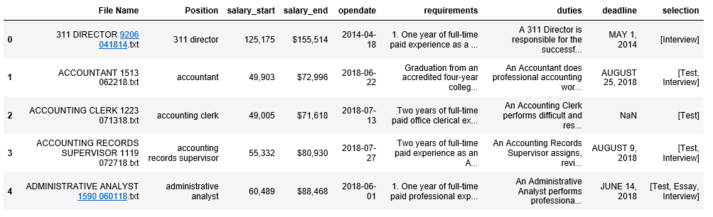
LOADING DATASET

Slide 7
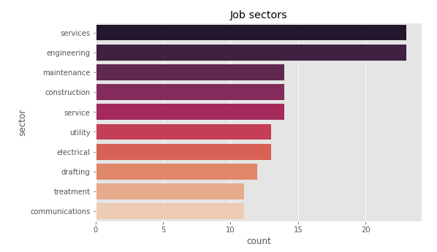
Common Job Sectors in LA

Slide 8
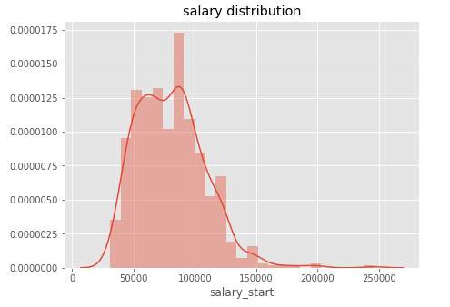
Salary Distribution

Slide 9
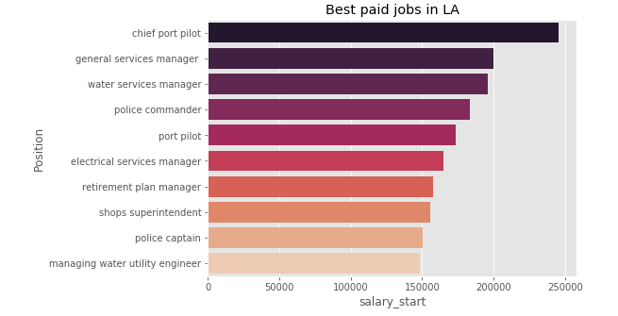
Best Paid Jobs In LA

Slide 10
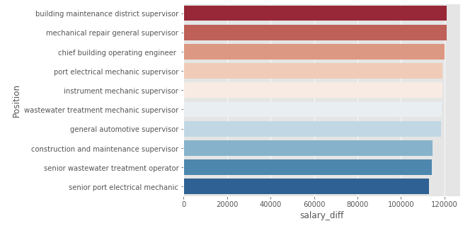
Jobs with highest Salary Deviation

Slide 11
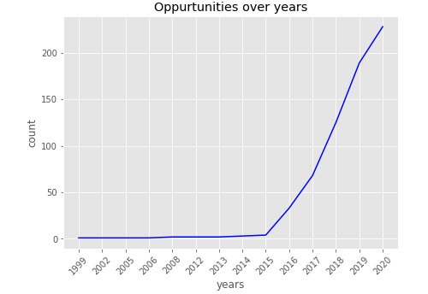
Has Job Opportunities increasing really?

Slide 12
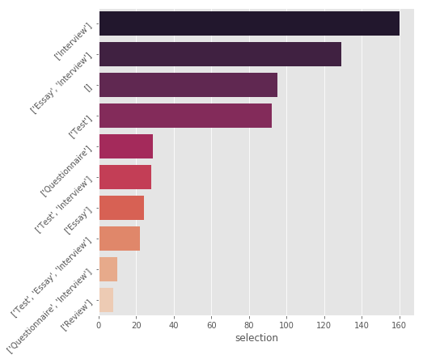
Common Selection Criterias

Slide 13


